Slide 1
AUTOMATION & IOT
TOUCH ME NOT ( BUZZER GAME)
1st MCA-A
L Vinay Kumar Reddy
2347126

Slide 2
Contents
Components Used.
Inputs.
Outputs.
Code Working.
Results.

Slide 3
Components Used.
Arduino UNO.
Sensor shield(SST technologies).
Buzzer, RGB light.
Jumper wires.
2sq,6sq-mm Wires.

Slide 4
INPUTS
6sq-mm Stand (6 as START, 7 as FAIL, 8 as END).
2sq-mm handle(GND).

Slide 5
OUTPUTS
RGB light (9,10,11).
Buzzer (3).

Slide 6
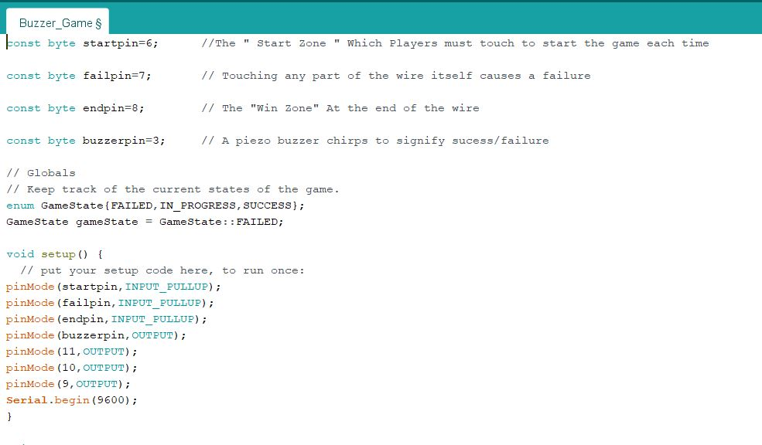
CODE WORKING

Slide 7
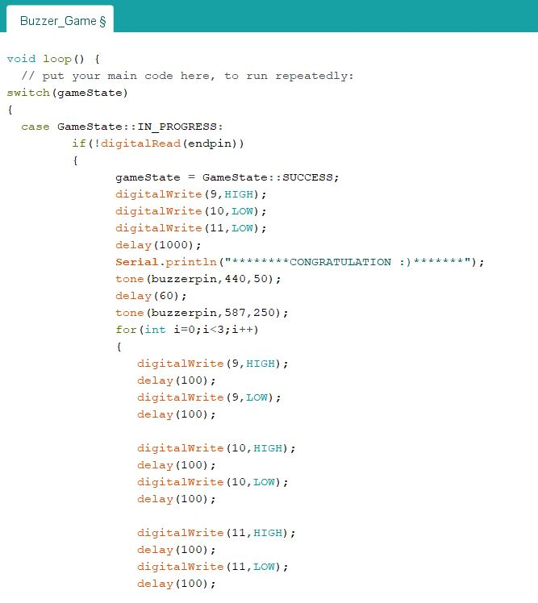
CODE WORKING

Slide 8
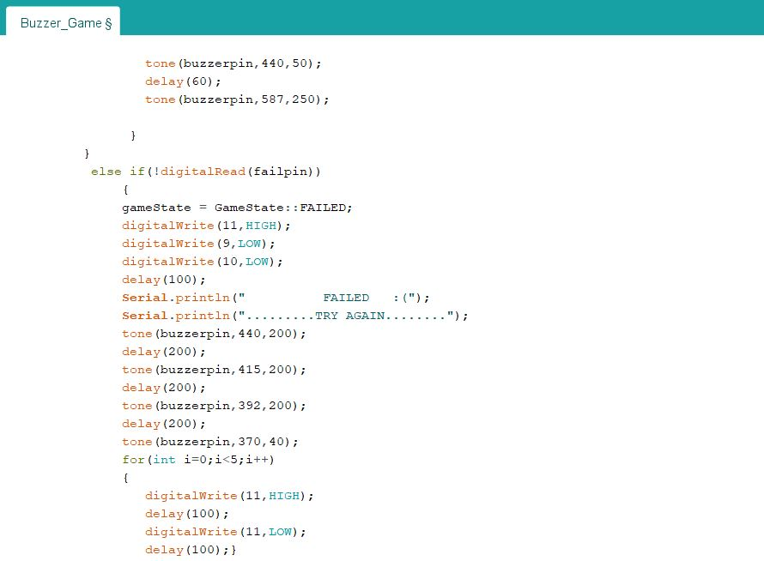
CODE WORKING

Slide 9
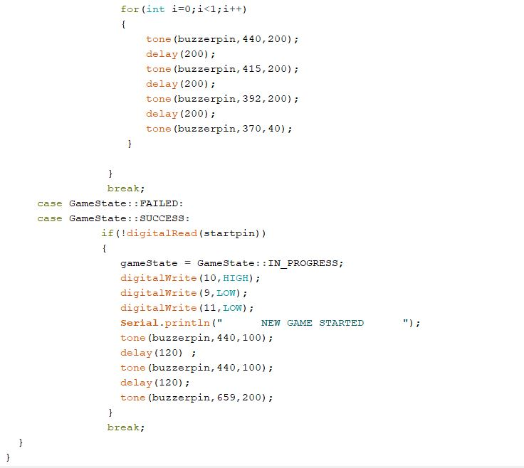
CODE WORKING

Slide 10
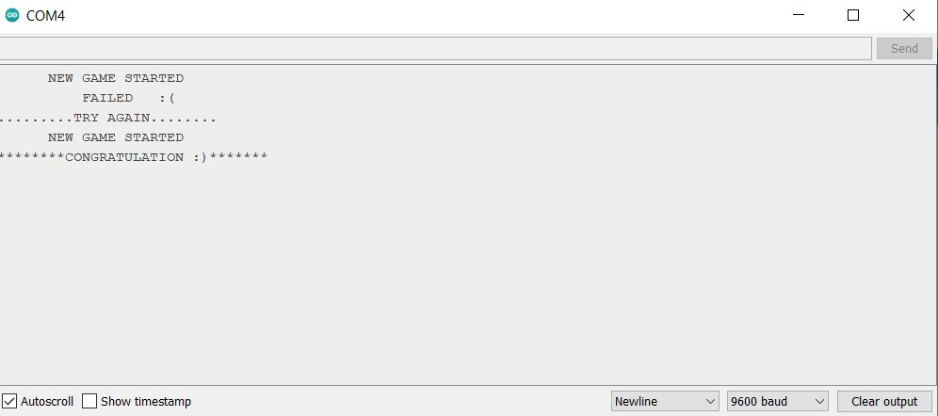
RESULTS

Slide 11
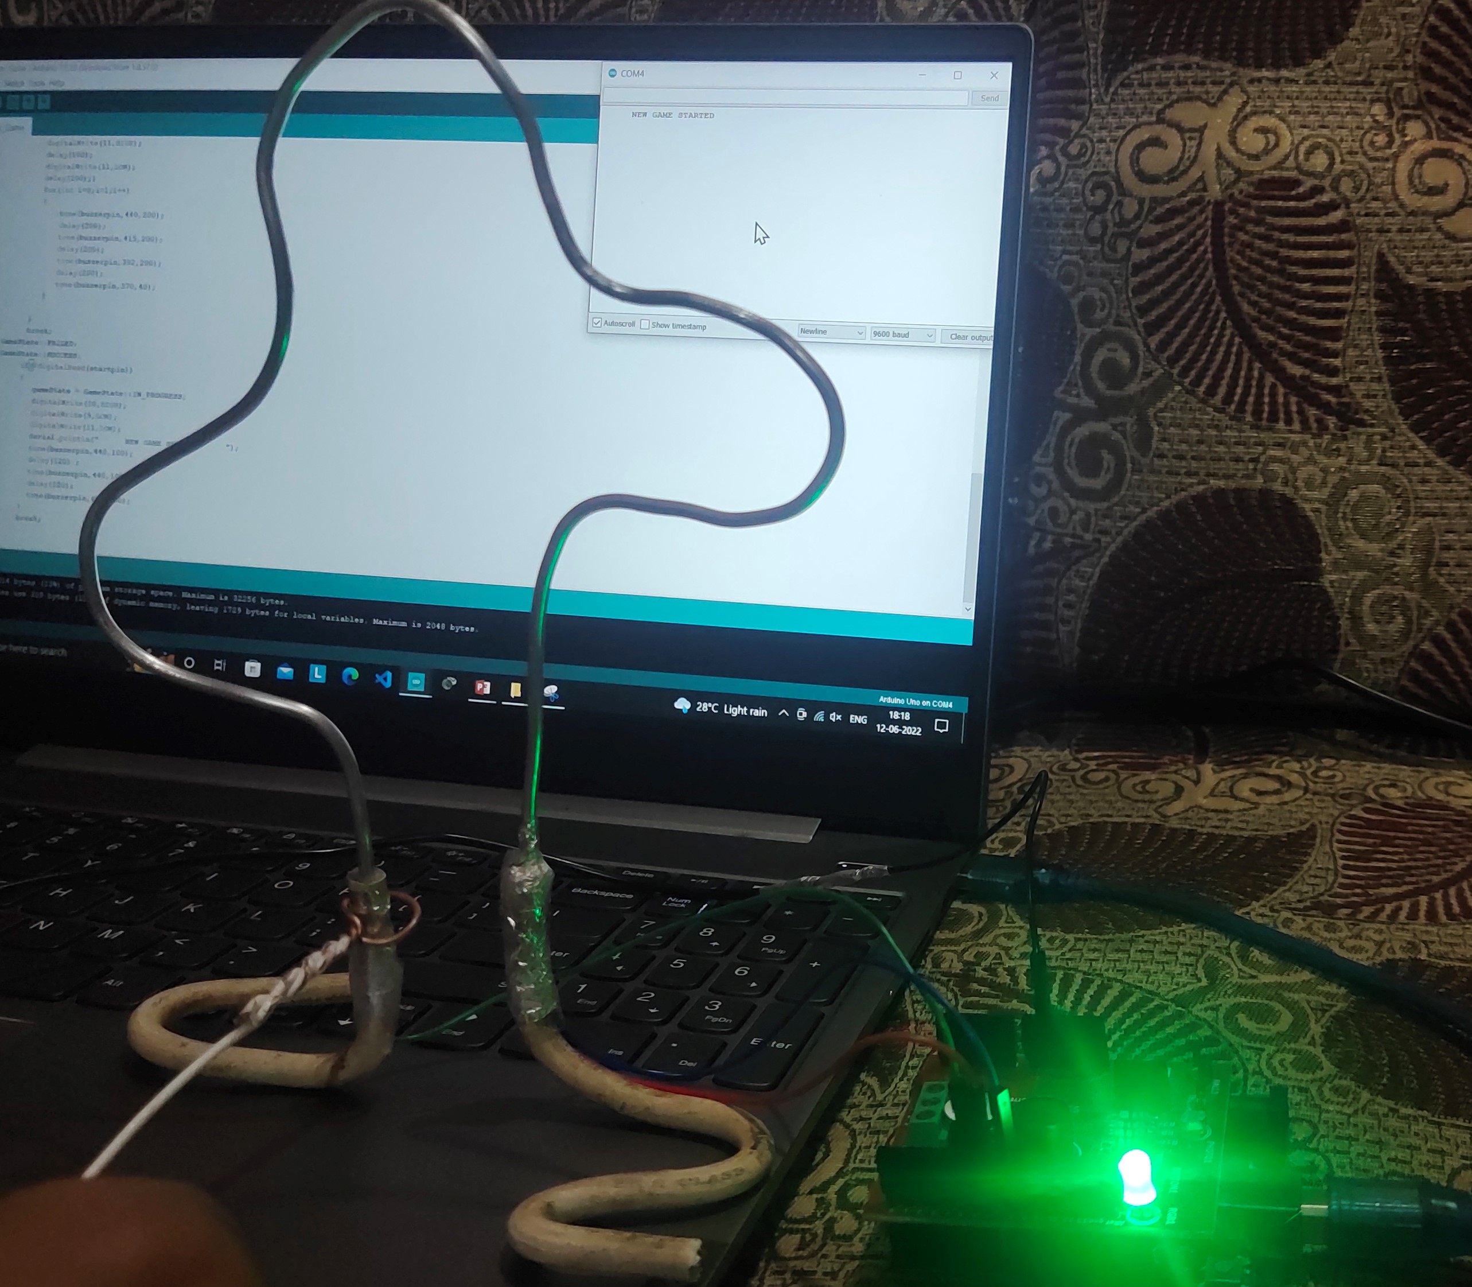
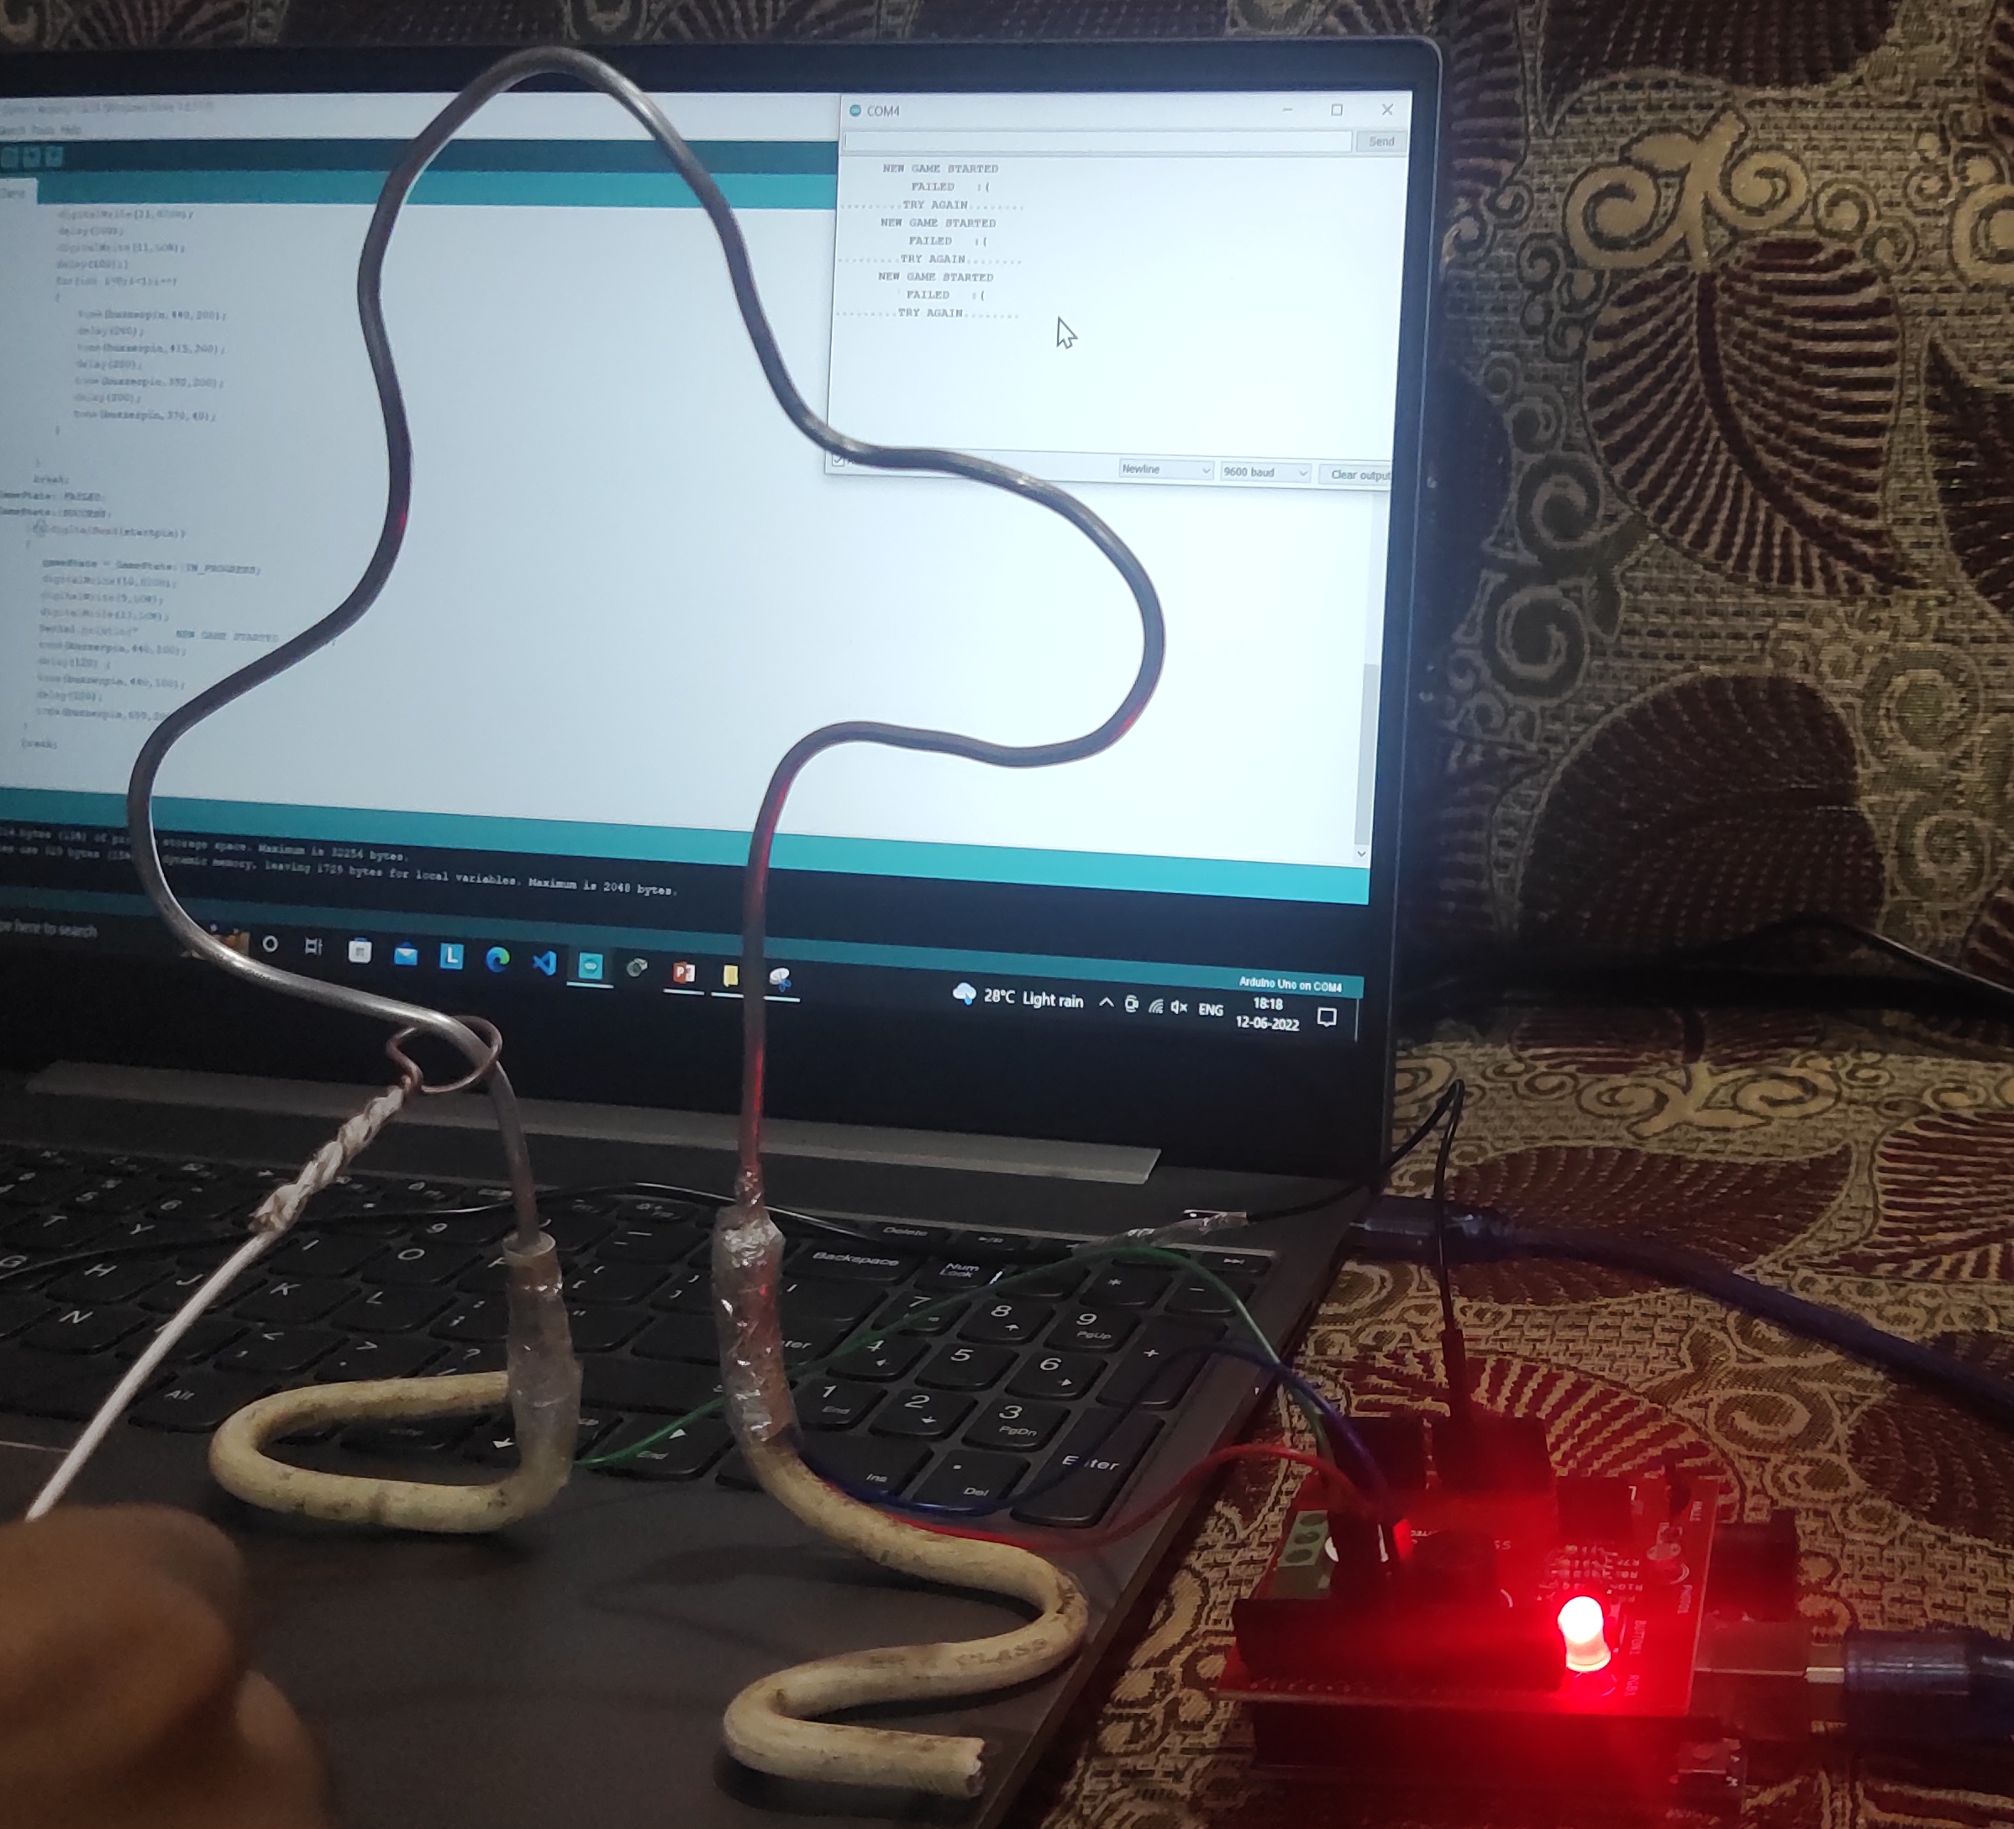
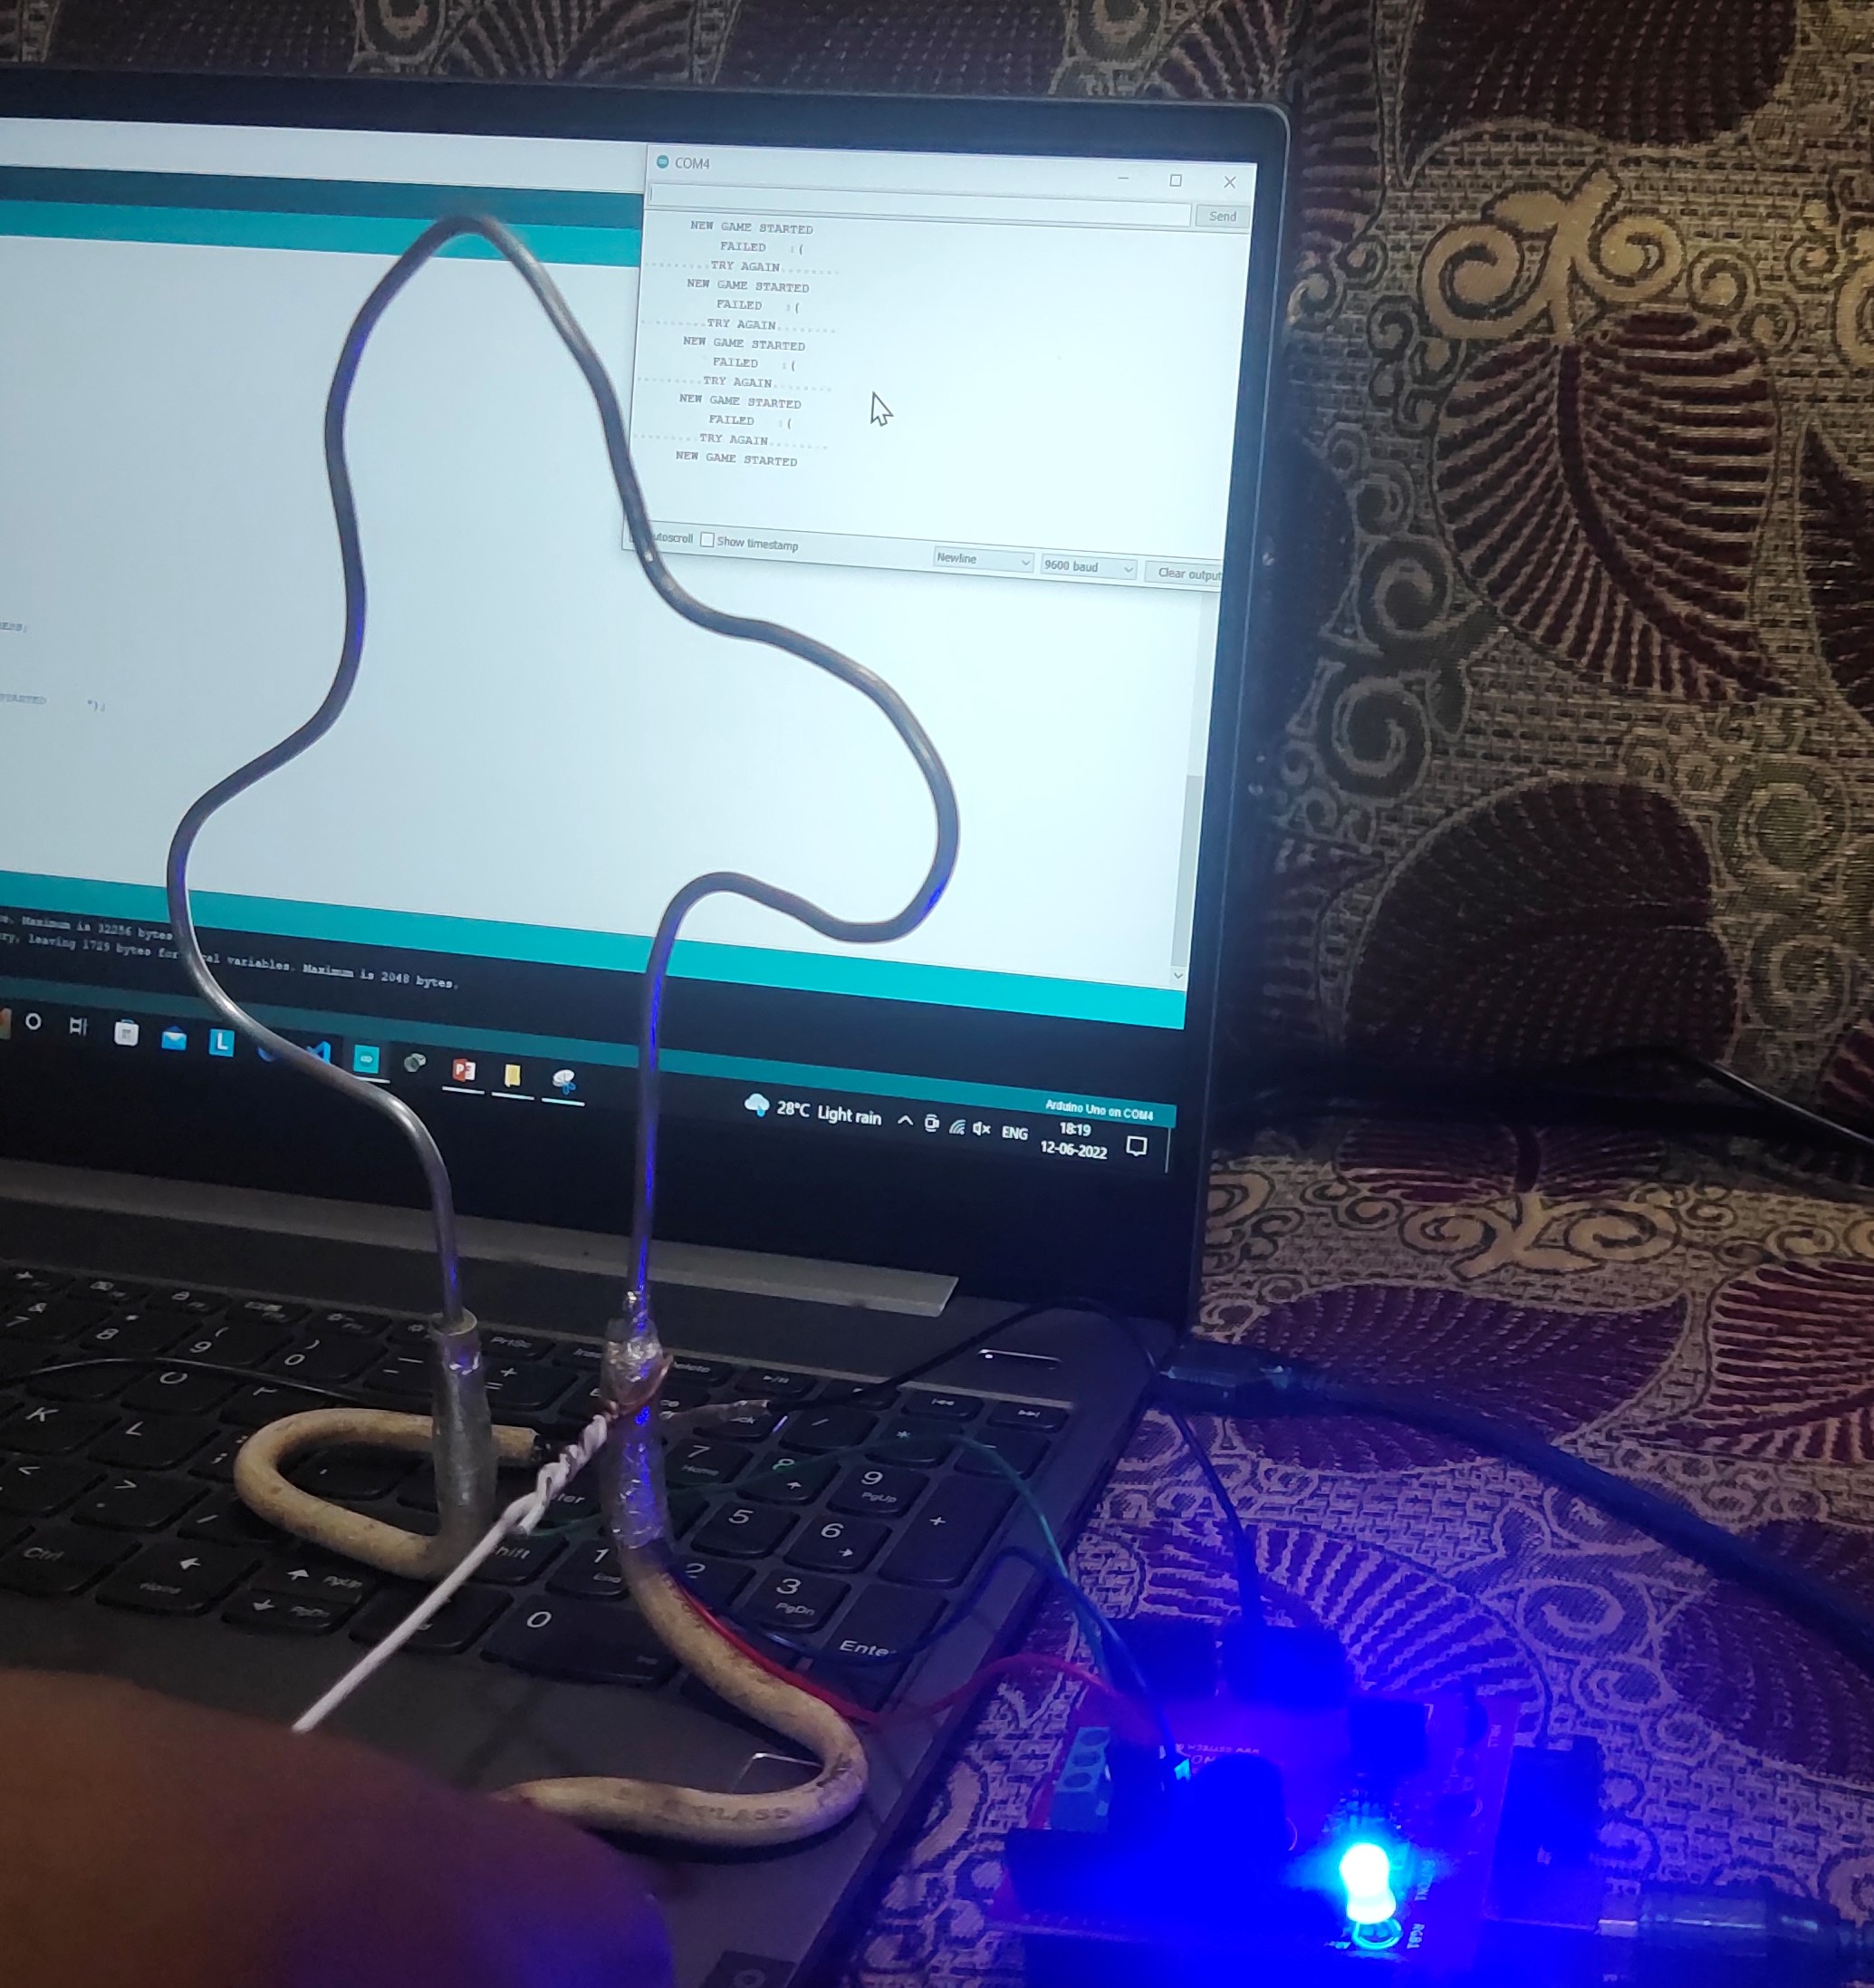
RESULTS
START POINT
FAIL POINT
FINISH POINT

Slide 12


